Slide 1
women’s Belt wrestling in Iran
Habibi hadi
deputy of international Iran wrestling institute
Masters physical education in university of Tehran kharazmi
e

Slide 2
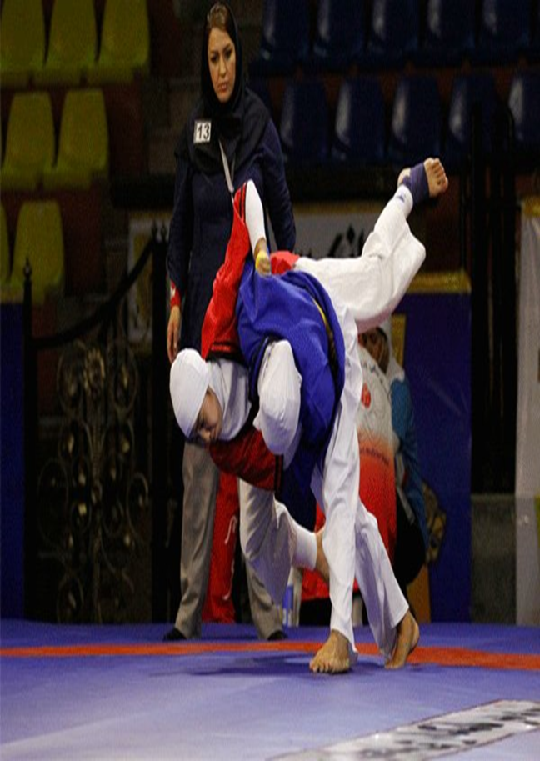
History of Traditional Belt Wrestling in The World
This sport has a long history in the world.
That name was Alyish or Belt wrestling.
Alysh was named by IFWB as a traditional wrestling.
Now all traditional wrestling are under control of UWW.
'
h

Slide 3
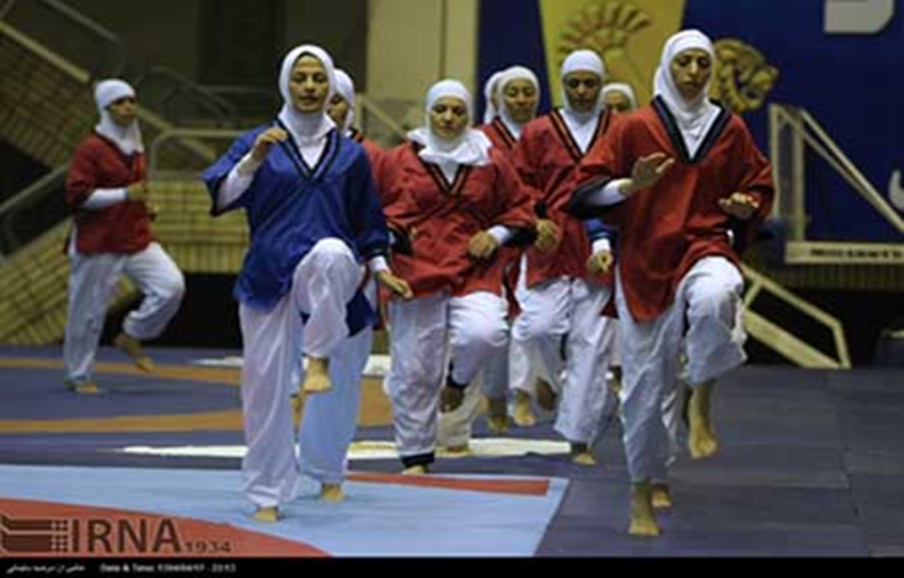
History of Belt wrestling in Iran
We had Belt wrestling in IRAN for a very long time.
it’s name was Alysh.
After changing the World Wrestling Federation (FILA) to UWW, and making traditional wrestling committee, we Named it Belt wrestling too.

Slide 4
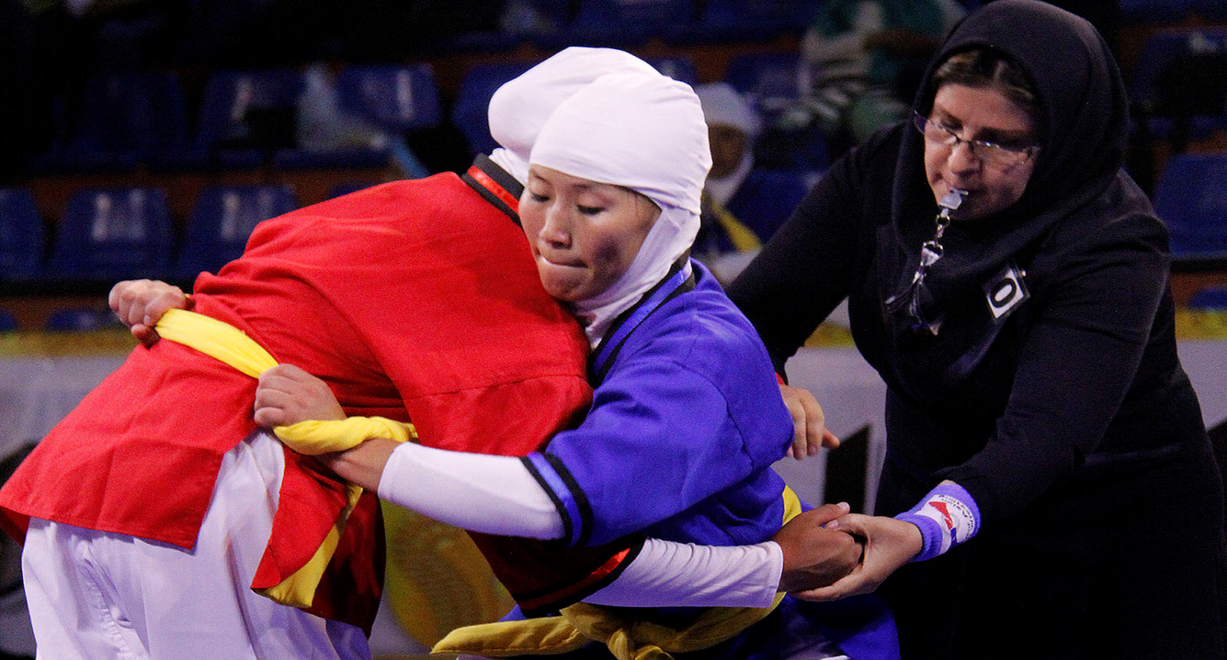
Women’s Sport in Iran
Women are provided the opportunity to compete in many Sports in Iran, even wrestling.

Slide 5
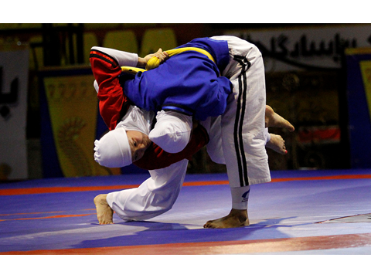
The future of women Belt wrestling in IRAN
But Belt Wrestling is going on in Iran for women with no limitation.
Iranian Women are very interested into inter to the world class of Belt wrestling.
Women Belt wrestling is not against Islamic culture.

Slide 6
Action of Mr. Rasoul Khadem, president of Iran
Mr. Rasoul khadem ,president of Iran wrestling Federation and a Olympic champion :
He started Women wrestling in Iran for the first time.
He hopes that, in the future, Iranian women belt wrestling, be more active in the world wrestling.

Slide 7
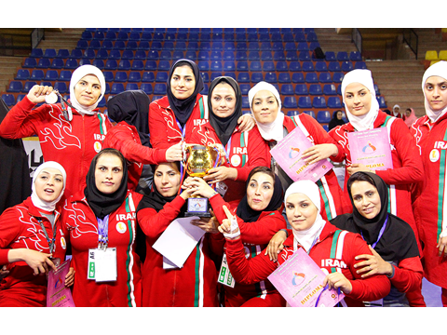
1st Asia belt wrestling Championship in 2015, Iran
The first Asian belt wrestling competition was held in Iran – 6 to 8 of August 2015.
Iranian women competed very powerful and strong in this competition.
IRAN became champion in this competition.

Slide 8
UWW FAMILY
We Hope United world wrestling family, with power of Traditional Wrestling, show better kind and quality of wrestling in the world.

Slide 9
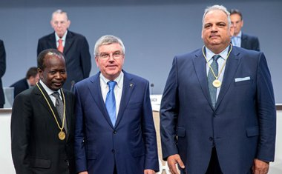
Saving Wrestling in Olympic games
We, as United World Wrestling family, believe in that, wrestling will save for ever in the Olympic games with full power.

Slide 10
THANK YOU FOR YOUR ATTENTION!

