Slide 1
Beginning and Development of Women’s Wrestling in Bulgaria
Sylvia Bakalova
National Sports Academy - Sofia

Slide 2
In Bulgaria wrestling is a national sport. It is often referred to as “the most Bulgarian sport”, “the golden sport”, “a manly sport”. Bulgarians recall legendary wrestlers’ names as Dan Kolov, Nikola Petrov, Boyan Radev, and Alexander Tomov when they think of wrestling. And although Bulgaria remembers female names of winners in wrestling combats held centuries ago, despite the fact that there have been female generals in the Bulgarian army and female pilots in our aviation, notwithstanding the undisputed pride of Olympic glory for all the women in a number of strength sports who have won Olympic titles for Bulgaria, there is still no univocal attitude towards women’s wrestling in Bulgarian society.

Slide 3
Some European countries began developing women’s wrestling in the 1970s. Officially, FILA approved women’s wrestling as a sport discipline along the free-style and Greco-Roman wrestling in 1984. Yet, in Bulgaria first steps for the development of women’s wrestling were only made a whole decade later. Why? The reasons for this delay are multifold:

Slide 4
The radical socio-economic and political changes in the late 1980s in Bulgaria led to the complete disintegration of the system of Bulgarian sports;
The media influencing the perception of women’s wrestling by the general public with articles entitled “Women’s wrestling – progress or deviation?”, negative comparisons and statements such as “men’s rhythmic gymnastics”, “Most people are unlikely to accept the sight of two women touching themselves so brutally.”;
The lack of appropriate and timely managerial decisions led to insufficient financing and the consequent grim future prospects for any development in this direction;
And last but not least, the lack of methodology and trained specialists and coaches willing to work with women.

Slide 5
The idea
The first impulse that initially stirred developments in women’s wrestling in Bulgaria was given by assoc. prof. Nikolai Dimitrov. He was a member of the national wrestling team as an athlete and later a wrestling coach at the National Sports Academy. Nikolai Dimitrov was the founder of the Bulgarian sumo wrestling, chairman of the Bulgarian Sumo Federation and the first senior coach of the national sumo team. During the years 1989-1993 he was a coach at the sports universities in Beijing, New Zealand, and Guam. N. Dimitrov was responsible for the wrestling practice of the men’s teams but he also coached children, boys and girls.

Slide 6
It was in these universities that he was very surprised by the attitude towards wrestling as a fundamental sport. For the boys it was a strength and technical preparation for other sport disciplines while for the girls wrestling was a preferred sports activity aimed at developing overall physical fitness and physical culture in general.
Upon his return to Bulgaria, N. Dimitrov created an optional programme at the National Sports Academy, i.e. women’s wrestling. This happened in 1994. The new course attracted a lot of attention and 30 female students enrolled. They were from different sports – judo, weight-lifting, even gymnastics.

Slide 7
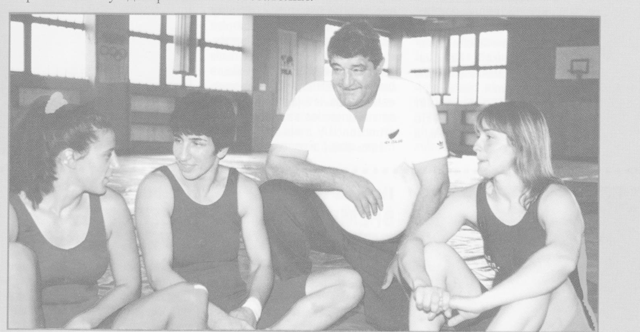
Some of those students formed the first national women’s team of wrestling, with coach N. Dimitrov (1994 – 2000). That same year, 1994, the capital of Bulgaria, Sofia, hosted a world championship of women’s wrestling.

Slide 8
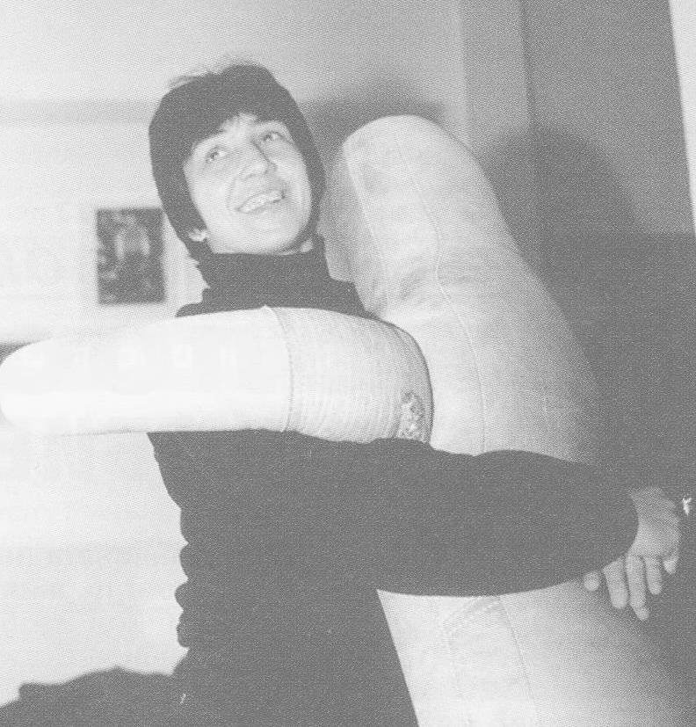
The Bulgarian team was not complete; nevertheless, the first medal in women’s wrestling was won at that tournament – a bronze for Elisaveta Toleva (a former competitor in judo). The consequences of this first victory piled up rapidly:

Slide 9
1. A new programme was offered at the National Sports Academy – women’s wrestling. In the fall of 1994 the first four ladies enrolled in that programme. Dozens have already completed their studies and graduated the Academy; however, only five women are currently working as wrestling coaches in Bulgaria.
2. The Bulgarian Wrestling Federation took the necessary steps and soon financing was secured for the preparation and participation in official competitions for women wrestlers.

Slide 10
3. The number of sports clubs offering female wrestling grew fast, so did their reputation. That was also due to an IOC decision to accept women’s wrestling as an Olympic discipline as from Athens 2004. Several centers of women’s wrestling in Bulgaria were formed that to this day are the most active and successful, namely, the National Sports Academy, Kyustendil, Dimitrovgrad, Vratsa and others. In 2000, the number of women wrestlers in all age groups was 89. In 2014, 263 competitors took part in national competitions of women’s wrestling (51 women, 40 juniors, 47 cadets, and 125 school girls); these figures have been comparatively stable in the last five years.

Slide 11
The three world championships held in Sofia, in 1994, 1996, and 2000, helped change the negative attitude in Bulgarian society. The presence of national and world sports leaders was reported in the media and that affected the overall view on women’s wrestling, leading to more positive comments including some traces of respect, even pride.

Slide 12
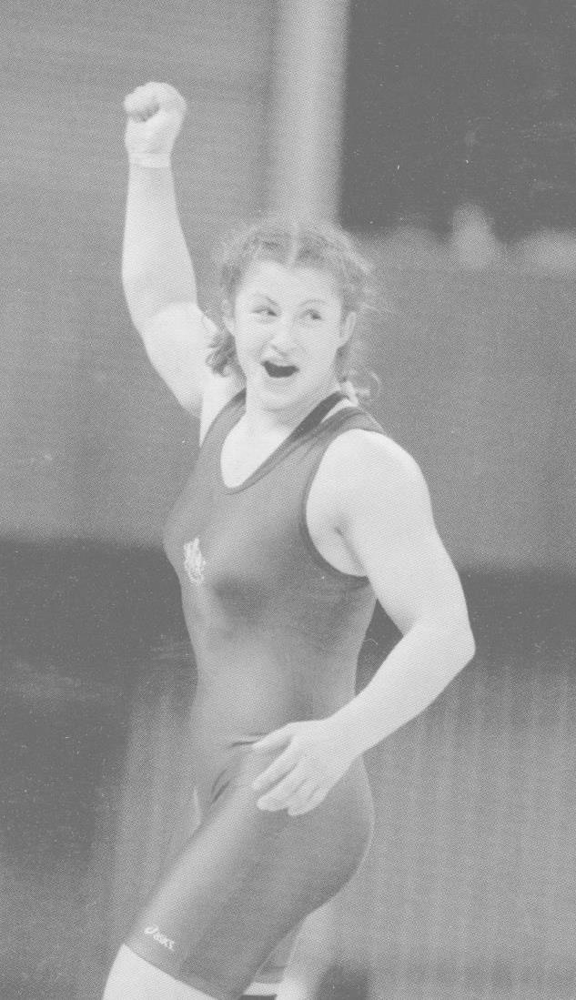
The success
Women first took part in world championships. The teams’ rankings were among 8th and 14th. For twelve years only 2 medals were won. In 2003, juniors Maya Hristova and Stanka Zlateva added two silver medals in Istanbul. The great breakthrough in women’s age category happened only in 2006 with the world title of Stanka Zlateva in Guangzhou.

Slide 13
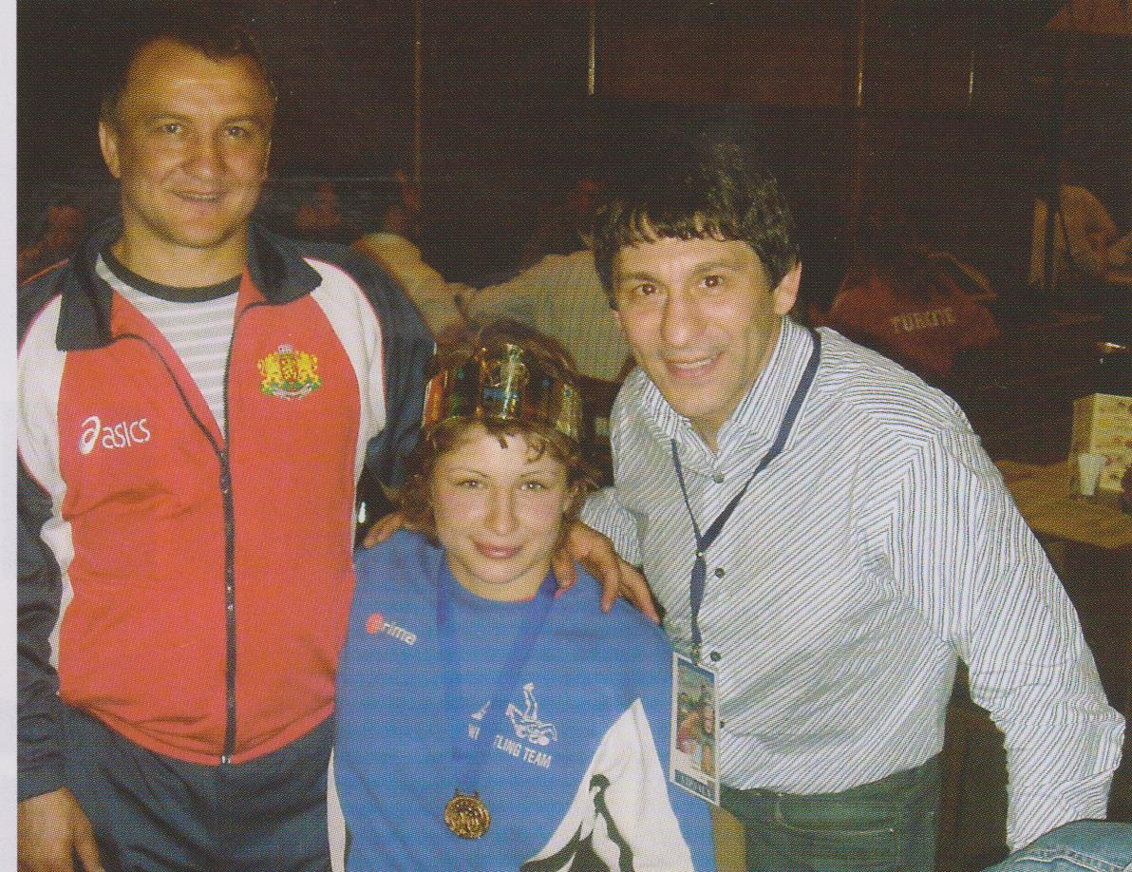
Participation in European championships began relatively late, in 1996, when competing with 14 other nations the Bulgarian women wrestlers took 8th place. The first small successes were those of juniors Vladislava Petrova and Valentina Raycheva (Patra, 1998) who won silver medals. A whole decade later a Bulgarian female wrestler became a European champion – Stanka Zlateva, Moscow 2006.

Slide 14
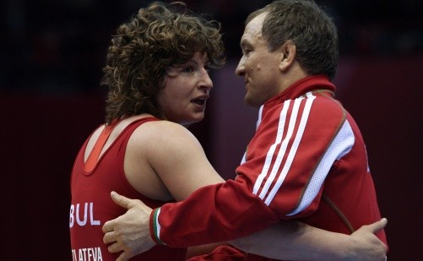
Today she is among the most successful athletes of Bulgaria, twice Olympic silver medalist, five times world and six times European champion. She was awarded the title № 1 female wrestler in the world in 2006, 2007, 2008, and 2010 by (FILA/UWW).
For Bulgaria she was Athlete № 1 in 2007,
2010, and 2011.

Slide 15
The total success in the development of Bulgarian women’s wrestling expressed in numbers for the period 1994-2014 is 78 medals in the following categories:
 | Women |  |  | TOTAL | Juniors |  |  | TOTAL | Cadets |  |  | TOTAL
 | 1 | 2 | 3 |  | 1 | 2 | 3 |  | 1 | 2 | 3
Olympic Games | - | 2 | - | 2 | - | - | - |  | - | - | -
World Championships | 3 | 3 | 3 | 9 | 2 | 3 | 3 | 8 | - | 2 | 2 | 4
European Championships | 3 | 3 | 11 | 17 | 4 | 5 | 12 | 21 | 1 | 3 | 13 | 17
Total | 6 | 8 | 14 | 28 | 6 | 8 | 15 | 29 | 1 | 5 | 15 | 21

Slide 16
For only two decades several young girls with great dreams and a lot of ambition succeeded in changing the attitude towards women’s wrestling in Bulgaria. They managed to make Bulgaria a world power in this well-respected and highly regarded sport, and currently their results at times outshine the glory of Bulgarian men wrestling in free-style and Greco-Roman styles.

