Slide 1
Sports Psychological Interventions
Theoretical and practical experience in women wrestling
MMag. Angelika Fetz-Hartmann
Notes:
My topics for todays presentation are Psychological Interventions in sports.
I would like to talk about some theoretical aspects first but mainly about the practical experiences in sports psychology.

Slide 2
Contents
GOAL SETTING
CLASSICAL MENTAL TRAINING (Eberspächer)
e.g. Suplex
MENTAL IMAGERY
Notes:
To enhance the performance of athletes in competition sports psychologists can draw on different interventions and techniques. I would like to present three key interventions which I have applied in coaching sessions with two female wrestlers. The three key interventions are goal setting, classical mental training and mental imagery.

Slide 3
GOAL SETTING
Development of an ACTION PLAN
Aim is MOTIVATION
Hard and focused WORK
SHORT TERM
MIDDLE TERML
LONG TERM GOALS
Notes:
First of all I am going to talk about GOAL SETTING.
Goal setting involves the development of an action plan. The aim is to motivate and guide a person or group toward a goal. Without goals you lack focus and direction.
Having a short, middle or long term goal can encourage an individual to work harder and to be more focused on the task.
An example for a short term goal could be: During the first round of this fight I will achieve to use my special technique twice.”
Important is that there are three different types of goals: Outcome, Performance and Process Goals

Slide 4
TYPES OF GOALS
OUTCOME – related to winning and losing –Specific results of Competition
- e.g. In National Championships I am first.
PERFORMANCE – are related to various statistics
- e.g. three times to five time – special technique
PROCESS – are related to performance goals – focus while performing a sport skill
e.g. focus on perfect performance of the special technique
Notes:
What are the types of Goals?
Weinberg & Gould (2003) distinguishes between outcome, performance and process goals. In our sessions we tried to focus on performance and process goals.
Outcome goals are related to winning and losing or specific results of a competition. These differ from performance and process goals.
Performance goals are related to various statistics that can help a person improve at what she is trying to do.
For example, a wrestler may analyze her fight and realize that she has to focuse more on her special technique. Thus a performance goal for the season may be to improve from hitting three times the special technique in one round to hitting five times in one round.
In addition to outcome goals and performance goals, a very important type of goal for athletes to set are process goals.
Process goals are related to performance goals; they are what the athlete should focus on while performing a sport skill.
For example, in addition to setting a performance goal of increasing the number of special techniques hit in regulation by 2 more, a wrestler may also set a goal to go through the same routine before she does the technique.
It is thought that the more one focuses on process goals, the less that person will worry about how she performs and hopefully will then perform better. Thus, the athlete, through learning to set process and performance goals rather than outcome goals, is setting goals that she has control over.

Slide 5
SMARTER GOALS
SPECIFIC – detailed, precise and clear
MEASURABLE – quantify them
ACHIEVABLE / ATTAINABLE
REALISTIC - high and realistic
TIME BOUND – date when
EVALUATE
RE - DO
Notes:
Outcome Goals, Process Goals and Performance Goals all need to be SMARTER:
SMARTER GOALS ARE:
(George T. Doran (1981))
Specific – that means - goals are precise and clear – we tried to make them as precise and detailed as possible. We tried to answer questions like: who is involved, what do I want to accomplish, where must this be done, etc…
Measurable – include precise amounts and dates in your goals, so you can measure the degree of success. You have to be able to answer questions like: how much, how many, how will I know when it is accomplished?
Achievable /Attainable - goals meet the common sense test that they require a change in current practices or behavior to be achievable. You figure out ways to accomplish your goals by developing the attitudes, abilities, skills and capacity to reach them.
Realistic - the goal is realistic yet challenging; A goal can be both high and realistic, you must decide for yourself.
You must truly believe that it can be accomplished.
Time bound – Goals must have a deadline – have an end point; you should know when to celebrate your success.
Evaluate - goals regularly and adjust them as needed
Re- Do goals after the evaluation process and iteratively go through the SMARTER process
Another important thing is that's very important when setting SMARTER goals, is formulating it POSITIVELY.
Commitment and self confidence will grow!

Slide 6
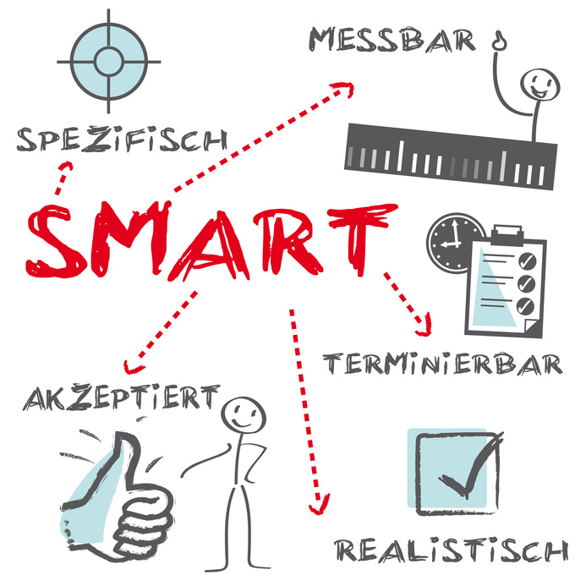
Notes:
Here you can see a picture we created for our smart goals – so that we know on what we have to focuse. Specific, mesurable, achievable, realistic and time bound.

Slide 7
Examples - Goal Setting in Wrestling
I get qualified for the world wrestling championships in Las Vegas 2015
I win this match
In the first round I make the two points with my special technique.
During the first round of this fight I will achieve to use my special technique twice.
I FIGHT with passion and full concentration
I am focusing on my body tension during my throws.
Notes:
Here I would like to show some examples for GOAL SETTING in Wrestling
I get qualified for the world wrestling championships in Las Vegas 2015
I win this match
In the first round I make the two points with my special technique.
During the first round of this fight I will achieve to use my special technique twice.
I FIGHT with passion and full concentration
I am focusing on my body tension during my throws.

Slide 8
CLASSICAL MENTAL TRAINING (Eberspächer Hans)
Mental Training of a new technique
Write down the movement sequences of the technique – include emotions and feelings
Athlete reads the sequences
Athlete memorises it – like in an inner film
Watch your inner film several times a day
Take five or six points of your film – define cruces (one, two, three for example)
Combine it with your Practical training – two mental sessions – five practical sessions for example
Notes:
Another focus in my work with the two athletes was classical mental training according to Hans Eberspächer.
This means Mental Training of a new technique.
Here we worked on combining the suplex with mental training to improve the athletes’ performance.
In the first step we wrote down the movement sequences as exact as possible. It is important to write down emotions and feelings as well.
Second step is that the athlete reads the sequences several times a day.
Then the athlete memorises it, like an inner film sequence. Next step is to watch the film.
After that they take five or six important points out of the film an define cruces. For example: one, two, three,
Or forward up throw
At last we combine it with the practical training – we take two mental sessions and five practical sessions
When it comes to practical training the athletes have a clear memorised sequence in their head to support and guide them through the suplex.

Slide 9
EXAMPLE - SUPLEX
I stand behind my opponent. I lock my arms around her waist. I step forward with my left foot. I get my hip so close to my opponent’s hip that I will be able to give my opponent an explosive push with my hip. My legs are bent. I straighten my legs and with an explosive push I pop her hips and back arch into the bridge. This explosive movement lifts my opponent in a high arch over my right shoulder onto the mat landing on both of her shoulders.
Notes:
Here i would like to show you how we did it in practise with the suplex!
I stand behind my opponent. I lock my arms around her waist. I step forward with my left foot. I get my hip so close to my opponent’s hip that I will be able to give my opponent an explosive push with my hip. My legs are bent. I straighten my legs and with an explosive push I pop her hips and back arch into the bridge. This explosive movement lifts my opponent in a high arch over my right shoulder onto the mat landing on both of her shoulders.

Slide 10
MENTAL IMAGERY
Same pattern in the brain
Visualize the fight before you go on the mat
For pre - competitive moods and competitive moods
Energy levels - nervous
Notes:
The third intervention was mental imagery.
Here the women wrestlers visualised themselves in a perfect competition.
Research has demonstrated that the same pattern of electrical changes in the brain occur whether an athlete is actually performing a physical task or simply imagining it. The brain interprets both the visualization and the physical performance the same.
„I try to visualize my fight before I wrestle. Like I`ll lie down and I’ll relax - - totally relax - - and just think how I’m going to wrestle, how I’m going to, you know, get on the mat, go into the fight and do my special techniques….“
Imagery can also be used to help adjust pre-competitive and competitive mood and energy levels
(for example, if you are too nervous, you can help yourself relax by mentally
taking yourself to a quiet, calm environment).

Slide 11
MENTAL IMAGERY
Familiarise with competition site
Motivation
Perfect skills
Reduce negative thoughts
Refocus
Notes:
What does MENTAL IMAGERY do?
First of all -
Familiarise the athlete with a competition site, competition hall, a race course or with a complex play pattern or routine.
Motivate the athlete by recalling images of their goals for that session, or of success in a past competition or beating a competitor in competition
Perfect skills or skill sequences the athlete is learning or refining
Reduce negative thoughts by focusing on positive outcomes
Refocus the athlete when the need arises: FOR EXAMPLE if performance is feeling sluggish, imagery of a previous best performance or previous best event focus can help get things back on track

Slide 12
MENTAL IMAGERY RULES
Be calm and relaxed
Use all senses
Control Mental Images
Practice simple
Practice, Practice, Practice
Notes:
Some Rules when you begin with Mental IMAGERY
Be calm and relaxed:
Imagery is most often effective when the mind is calm and the body is relaxed. If your body feels tense, take a few minutes to relax and get yourself focused. If you get distracted while practicing imagery, let the distracting thoughts and images float past as you reflect on the image.
Use all the senses: Often, athletes only use their visual sense when imaging-- seeing themselves perform. But equally important is feel, sound, thoughts, body position, and even smell and taste, as these are all part of the athletic experience. Paying attention to the detail of such sensations related to wrestling can help make imagery more vivid.
Control the Mental Images: In addition to vividness, being able to control images--making sure you see and feel yourself perform as you want to perform--is another vital piece of successful imagery.
At first, keep imagery practice simple: It is generally best to first learn and practice imagery in a quiet environment with few distractions. Start by imaging basic objects or places such as your bedroom or a lemon. Try to manipulate the image - - move the furniture in your room or peel the lemon. The key is to first learn how to create and recreate mental images. Later, this skill can be applied to wrestling
Practice, practice, practice: Remember that--just like physical skills—mental imagery can only be improved through practice. Spend time every week working on imagery skills. This can be made easier by setting aside a particular time of day to use for imagery training.
There is no correct way to practice mental imagery. It is all left up to individual preferences and the present circumstances. It can be done „on or off the field“, very short or of a long duration, sitting up, lying down with eyes closed or open. Everybody must find the perfect way for themselves.

Slide 13
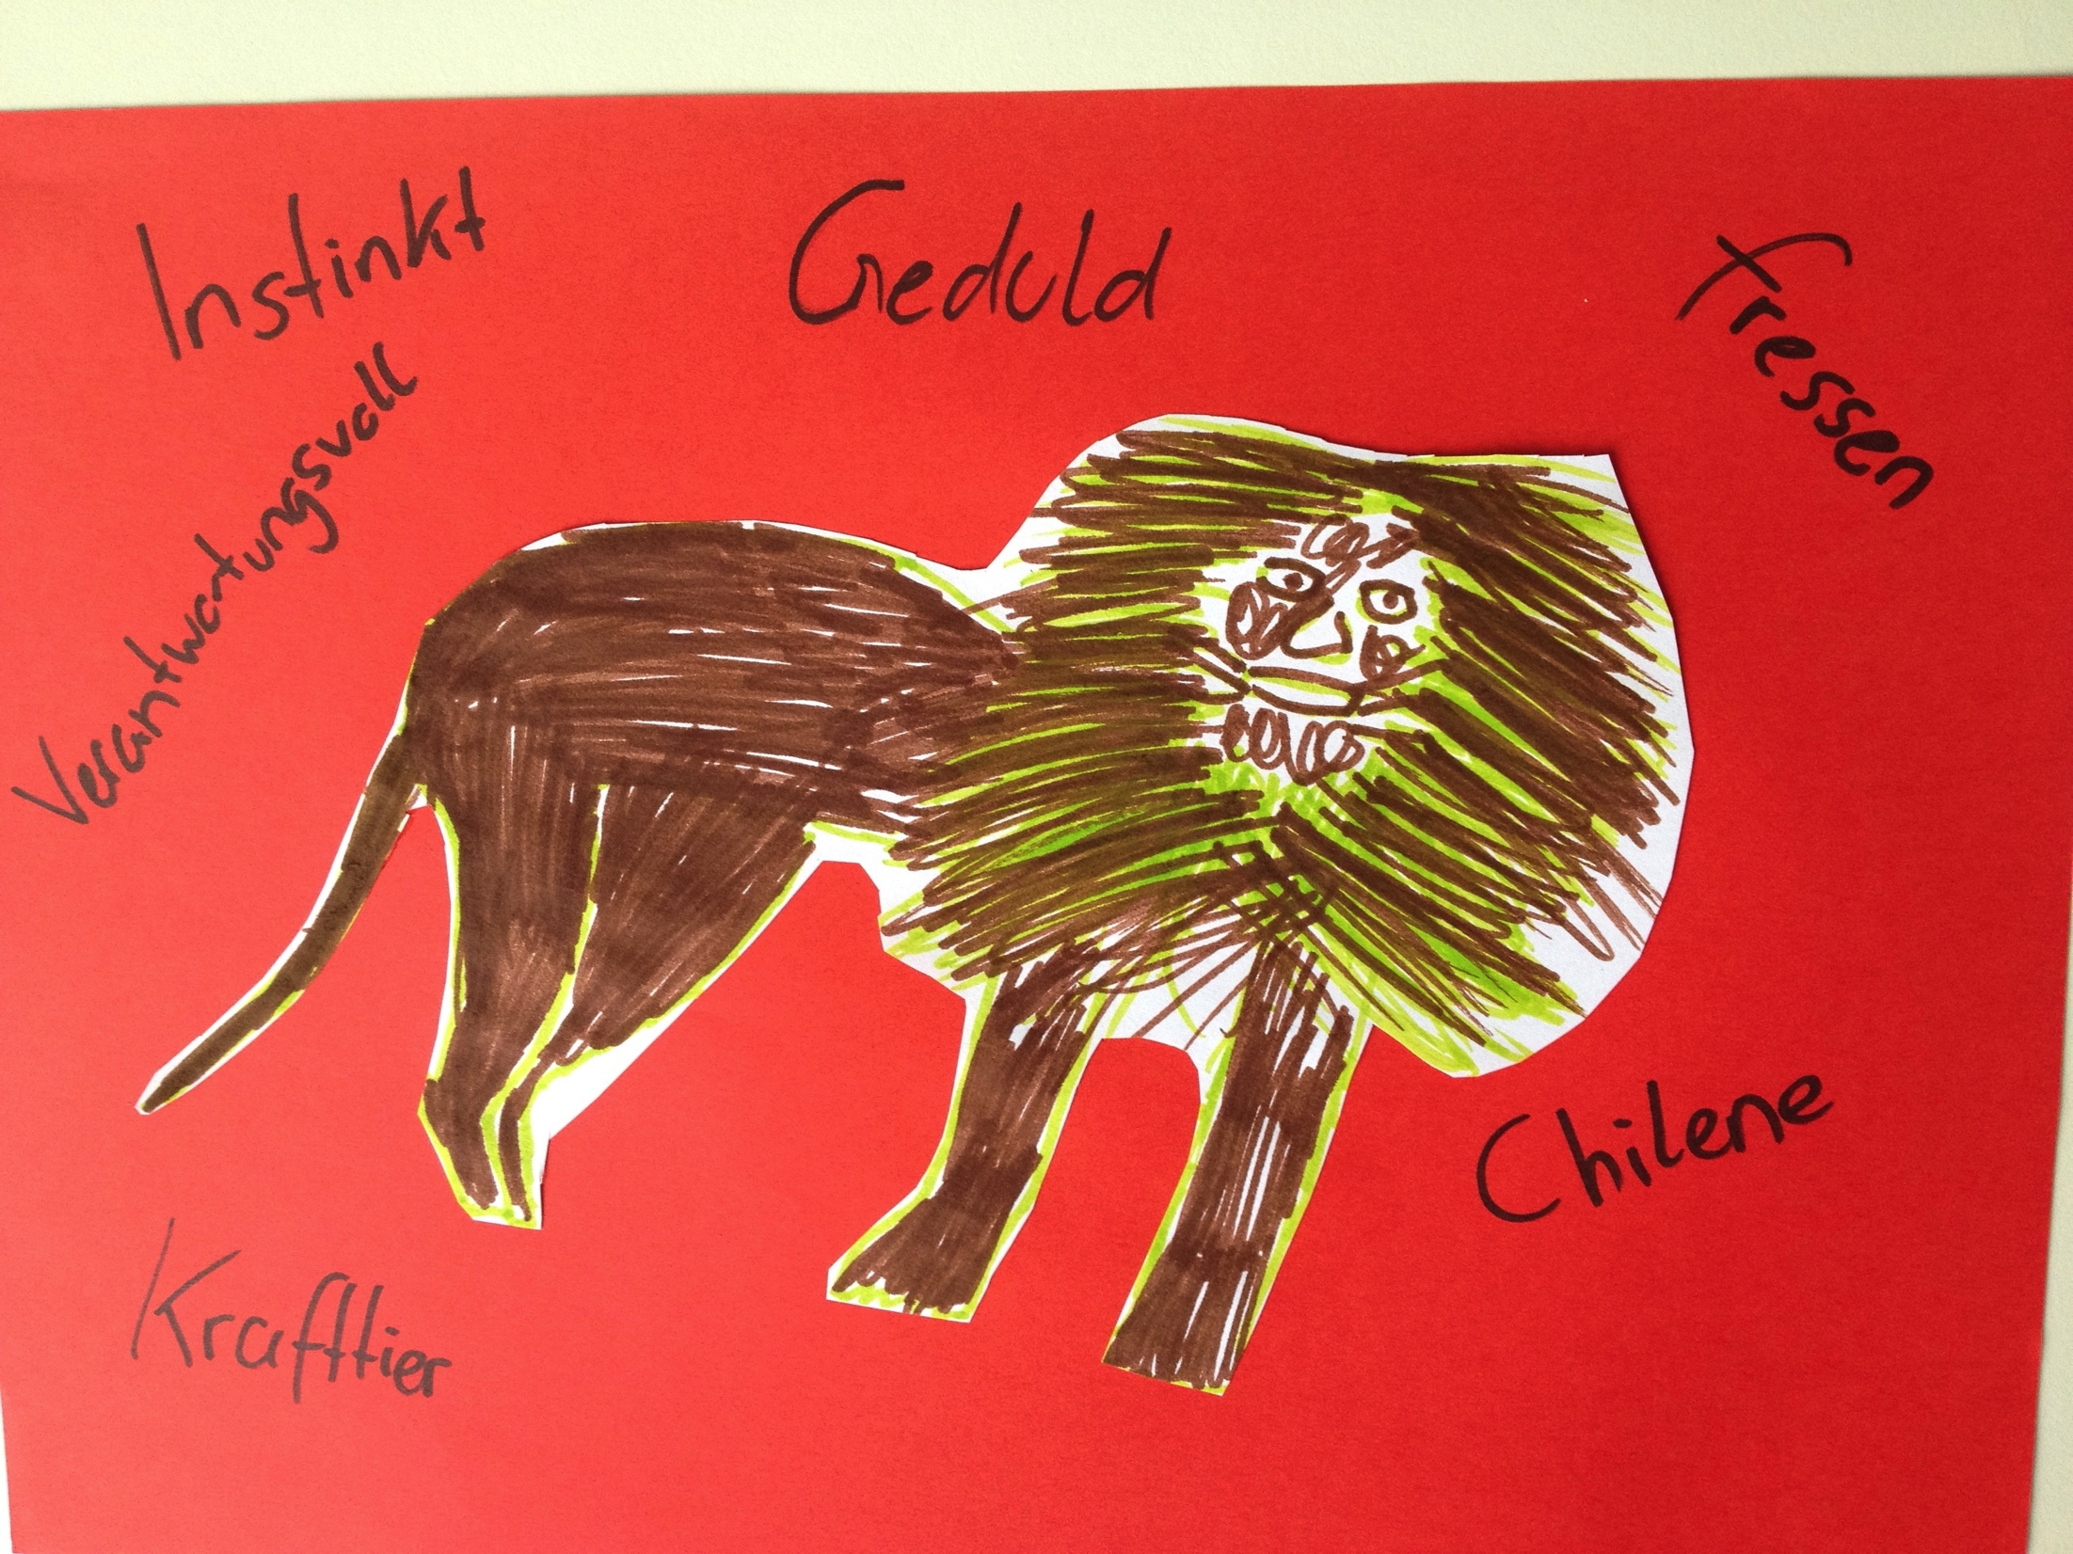
Power Pictures
Notes:
Here you can see two examples of a power picture which we use for the competition. Before the fight begins the athlete looks at her picture and image that she is strong as a lion or quick as a bear.

Slide 14
MENTAL IMAGERY BENEFITS
self confidence
pre-competition and competition strategies - teach athletes to cope with new situations
focus attention or concentrate on a particular skill
mentally practicing a motor skill influences performance somewhat better than no practice at all
Notes:
Which are the benefits of mental imagery.
MENTAL IMAGERY is developing self confidence
It also developing pre-competition and competition strategies which teach athletes to cope with new situations before they are actually in the situation and encounter them
MI is helping the athlete to focus her attention or concentrate on a particular skill she is trying to learn or develop in the competition situation.
Mentally practicing a motor skill influences performance somewhat better than no practice at all

Slide 15
SUMMERY
Three interventions with two athletes
Helpful for Motivation
Learned how to set goals correctly
Helpful for learning a new technique
Helpful for handling situations in training and competition
Notes:
Both athletes go through the three interventions. Generally they said that it was helpful for them. They learned how to set goals and they were more motivated to reach them. So they realized how important it is to set goals in sports.
By learning the suplex they said that it was very good for them to have clear images of the movement sequences.
Furthermore they can now better handle situations in training, just before competition and in competition.

Slide 16
Literature
Almer,W., Bernatzky, P., Knörzer, W. (2006). Integratives Mentaltraining im Sport. Aachen: Meyer&Meyer.
Amesberger. G. & Schauer, G. (1999). Sportpsychologie für TrainerInnen. Wien: Manuskript der BSO.
Anderson, M. (2005). Sports Psychology in Practice. Melbourne: Human Kinetics.
Aufderklamm, M. (2006). Angewandte Sportpsychologie.
Baumann, S. (1993). Psychologie im Sport. Aachen: Meyer&Meyer.
Doran, G. T. (1981). There’s a S.M.A.R.T. way to write management’s goals and objectives. Management Review, Volume 70, Issue 11(AMA FORUM), pp. 35-36.
Eberspächer, H. (1990). Mentales Training. München: Copress.
Frester, R., Wörz, T. (1997). Mentale Wettkampfvorbereitung. Ein Handbuch für Trainer, Übungsleiter, Sportlehrer und Sportler. Göttingen: Vandenhoek
Kogler, A. (2006). Die Kunst der Höchstleistung. Sportpsychologie, Coaching, Selbstmanagement. Wien: Springer.
Suinn, R. M. (1989). Mentales Training. In sieben Schritten zur sportlichen Höchstleistung. Bern, Stuttgart, Wien: Hans-Huber.
Syer, J. & Connoly, C. (1988). Psychotraining für Sportler. Reinbek: rororo.
Weinberg, R. & Gould, D. (2003). Foundations of sport and exercise psychology. Melbourne: Human Kinetics

Slide 17
Thanks for your attentions
Email: angelika.fetz-hartmann@univie.ac.at

